Slide 1
Embedded Hardware: Hardware Building Blocks
Unit -2

Slide 2
Topics to be discussed
Basic Notations describing hardware design
Diagrams
Symbols
Embedded Board
Von-Neumann Model
Semiconductors
Active Building Blocks of Processors and Memory

Slide 3
Engineering Hardware drawings
Created by hardware engineers
Used to describe the hardware designs to the outside world.
Block diagram
Major components of board – processors, buses, I/O, memory
A basic overview of the hardware, with implementation details abstracted out.
Pros: Simple, basic overview – basis for detailed hardware diagrams
Cons: Not detailed enough for software engineer
Schematics
Electronic circuit diagrams that provide a more detailed view of all of the devices within a circuit or within a single component—everything from processors down to resistors.
Depicts the flow of data in the system.
Schematic symbols are used to depict all components.
Helpful in debugging – hardware and software.

Slide 4
Wiring diagrams
Represent the bus (represented by vertical and horizontal lines) connections between the major and minor components on a board or within a chip.
Approximate depiction of the physical layout of component/board.
Logic diagrams
Show a wide variety of circuit information using logical symbols (AND, OR, NOT, XOR, and so on), and logical inputs and outputs (the 1’s and 0’s).
Timing diagrams
display timing graphs of various input and output signals of a circuit, as well as the relationships between the various signals.

Slide 5
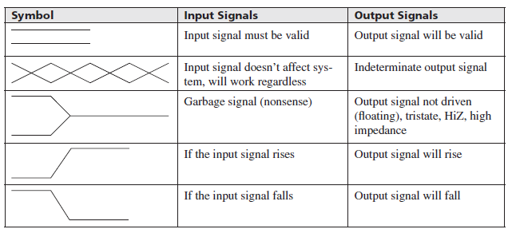
Symbols, Conventions & Rules
Regardless of the type, in order to understand how to read and interpret these diagrams, it is first important to learn the standard symbols, conventions, and rules used.
Timing diagrams symbol table

Slide 6
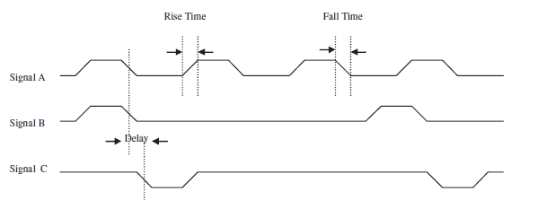
Timing diagram example

Slide 7
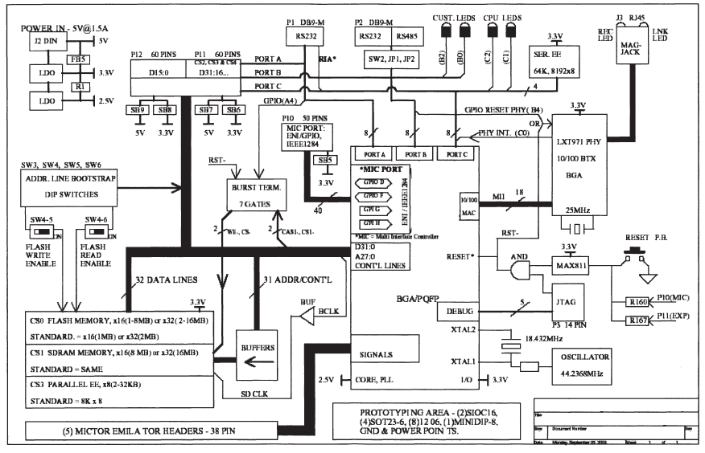
Schematic diagram example

Slide 8
Schematic Diagram – Conventions:
Title section : Name, hardware engineer, date, list of revisions
Schematic symbols
Labels – pin numbers, IC, size, type, power etc.
Abbreviatons and prefixes: Eg. k –kilo, M – Mega
Functional groups of components
I/O and Voltage source/Ground terminals

Slide 9
The Embedded Board and the von Neumann Model
In embedded devices, all the electronics hardware resides on a board, called printed circuit board (PCB).
Major hardware components of most boards can be classified into five major categories:
Central Processing Unit (CPU) – the master processor
Memory – where the system’s software is stored
Input Device(s) – input slave processors and relative electrical components
Output Device(s) – output slave processors and relative electrical components
Data Pathway(s)/Bus(es) – interconnects the other components, providing a “highway” for data to travel on from one component to another, including any wires, bus bridges, and/or bus controllers

Slide 10
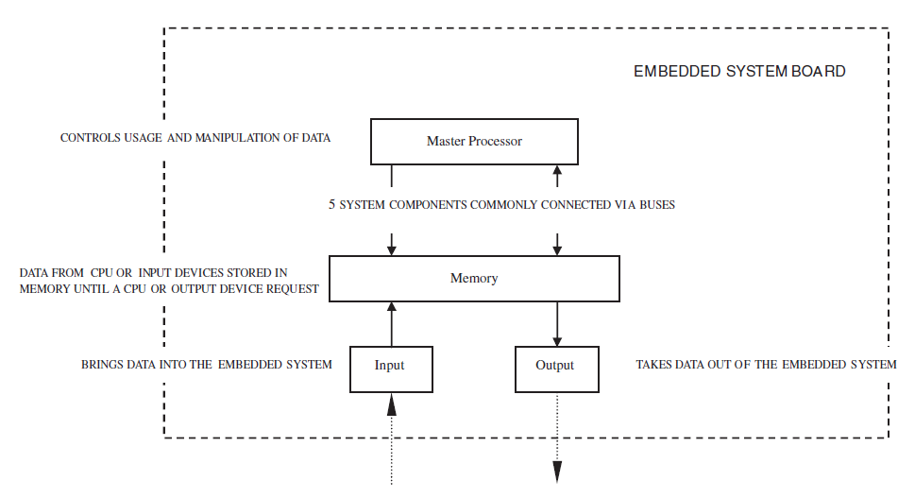
Von Neumann model
Embedded system board organization

Slide 11
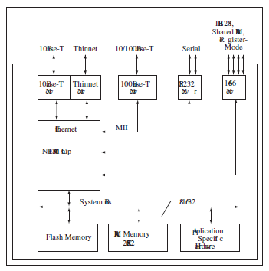
Net Silicon ARM7 reference board

Slide 12
Basic Components
Before major components of embedded board, lets see basic components.
Embedded board is made of interconnected basic electronic devices
Wires, resistors, capacitors, inductors, and diodes
Components can be classified into
Active components: components capable of delivering, receiving and storing power.
Eg: transistors, diodes
Passive components: components which can only receive and store power Eg.: wires, capacitors, resistors

Slide 13
Basic Hardware Materials
Conductors: fewer impediments to an electric current. Eg. Metals – easily loose/gain valence electrons
Insulators: impede electric current. Paper – less likely to loose/gain valence electrons
Semiconductors: base elements have a conductive nature that can be altered by introducing other elements into their structure

Slide 14
Semiconductors
Materials whose base elements have a conductive nature that can be altered by introducing other elements (impurities) into their structure.
Example- silicon, germanium etc.
It can be of 2 basic types:
P-type
Impurities called acceptors, such as boron, produce a shortage of electrons, creating a P-type semiconductor material.
N-type
Impurities (like arsenic, phosphorus, antimony, etc.), called donors, create a surplus of electrons creating an N-type semiconductor.

Slide 16
Active Building Blocks of Processors and Memory
P-type and N-type semiconductors must be combined to be able to do anything practical.
When P-type and N-type semiconductors are combined, the contact point, called the P-N Junction,
Acts as a one-way gate
Allow electrons to flow within the device in a direction dependent on the polarity of the materials.
P and N-type form some of the most common basic electronic devices that act as the main building blocks in processor and memory chips:
Diodes
Transistors

Slide 17
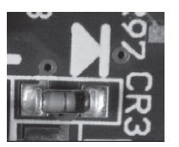
(Cntd…)
Diodes-
Semiconductor device made up of two materials, one P-type and one N-type joined together. A terminal is connected to each of the materials, called an anode and a cathode.
Rectifier diode(AC to DC),PIN as switches, zener diodes for voltage regulation etc.,
Forward biasing
Current flows through a diode from the anode to cathode as long as the anode has a higher (positive) voltage
Reverse biasing
When current will not flow through the diode because the cathode has a higher (positive) voltage than the anode
Diode and light emitting diode (LED)

Slide 18
(Cntd…)
Transistor
current-transferring resistor
Made up of some combination of P-type and N-type semiconductor material, with three terminals(emitter, base, and a collector) connecting to each of the three materials.
used for a variety of purposes,
current amplifiers (amplification),
in oscillators (oscillation),
in high-speed integrated circuits (ICs)
and/or in switching circuits(DIP switches, push buttons)

Slide 19
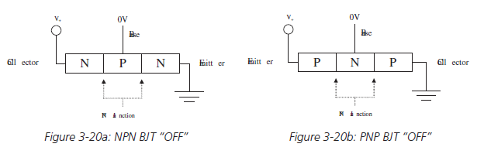
(Cntd…)
Two main types of transistors are:
Bipolar junction transistor (BJT)
Made up of three alternating types of P-type and N-type material,
Are sub-classed based on the combination of these materials.
NPN BJT
is made up of two sections of N-type material, separated by a thin section of P-type material
PNP BJT
is made up of two sections of P-type materials, separated by a thin section of N-type material

Slide 20
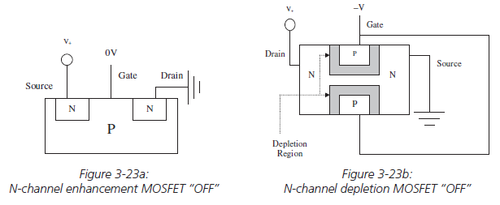
(Cntd…)
Field effect transistor (FET)
Made up of some combination of P-type and N-type semiconductor material, with three terminals
The terminals are called a source, a drain/sink, and a gate.
FETs do not require a biasing current, and are controlled via voltage alone.
The 2 most common types:
Metal-Oxide-Semiconductor FET(MOSFET)
Junction field-effect transistor (JFET).

Slide 21
Embedded Processors
Topics to be discussed:
Introduction
ISA Architecture Models
Internal processor design
Processor Performance

Slide 22
Embedded Processors- Introduction
Processors:
main functional units
primarily responsible for processing instructions and data.
An electronic device contains at least one master processor,
There can be additional slave processors, controlled by the master processor.
Slave processors may either extend the instruction set of the master processor or act to manage memory, buses, and I/O devices.

Slide 23
The complexity of the master processor usually determines whether it is classified as a microprocessor or a microcontroller.
Traditionally, Microprocessors contain a minimal set of integrated memory and I/O components
Microcontrollers have most of the system memory and I/O components integrated on the chip.
Though traditional definitions may not strictly apply to recent processor designs.

Slide 24
Architectures
Embedded processors can be separated into various “groups” called architectures.
What differentiates one processor group’s architecture from another is the set of machine code instructions that the processors within the architecture group can execute.
Processors are considered to be of the same architecture when they can execute the same set of machine code instructions.

Slide 25
ISA Architecture Models
Instruction Set Architecture or ISA
The features that are built into an architecture’s instruction set.
defines such features as:
the operations,
the operands (data),
storage,
addressing modes, and
the handling of interrupts.

Slide 26
Operations
Operations are made up of one or more instructions that execute certain commands.
Different processors can execute the exact same operations using a different number and different types of instructions
Functions that can be performed on the data, and they typically include computations (math operations), movement, branches, input/output operations, and context-switching operations
Eg.: 8051 – over 100 instructions for all operations

Slide 27
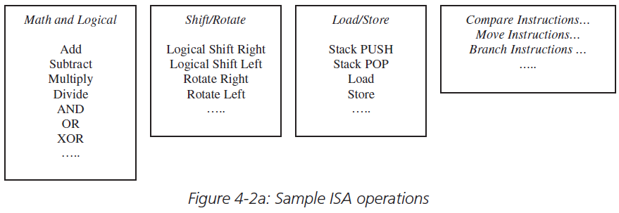
Operations

Slide 28
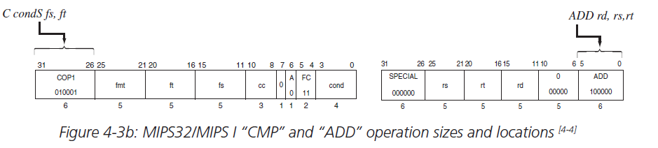
Operation Formats
The format of an operation is the actual number and combination of bits (1’s and 0’s) that represent the operation.
Referred as ‘Operation code’ or ‘opcode’

Slide 29
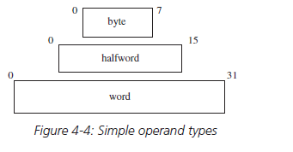
Operands
Data that operations manipulate.
An ISA defines the types and formats of operands for a particular architecture.

Slide 30
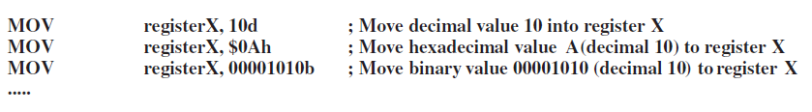
Operand Format
An ISA also defines the operand formats (how the data looks) that a particular architecture can support, such as binary, decimal and hexadecimal

Slide 31
Storage
Features of programmable storage as per ISA:
The organization of memory used to store operands:
Memory – array of storage that stores data
Indices – memory addresses
Actual range of addresses available to processor – address space
Characteristics:
Linear
Segmented
ISA defines where data is stored and how it is stored in memory.
Eg. Big-endian or little endian

Slide 32
2. Register Set
A register is simply fast programmable memory normally used to store operands that are immediately or frequently used.
A processor’s set of registers is commonly referred to as the register set or the register file.
Depends on processor – register size will vary
3. How Registers are used
ISA defines which register can be used for what transactions.
Eg.: Special purpose, floating point, general purpose

Slide 33
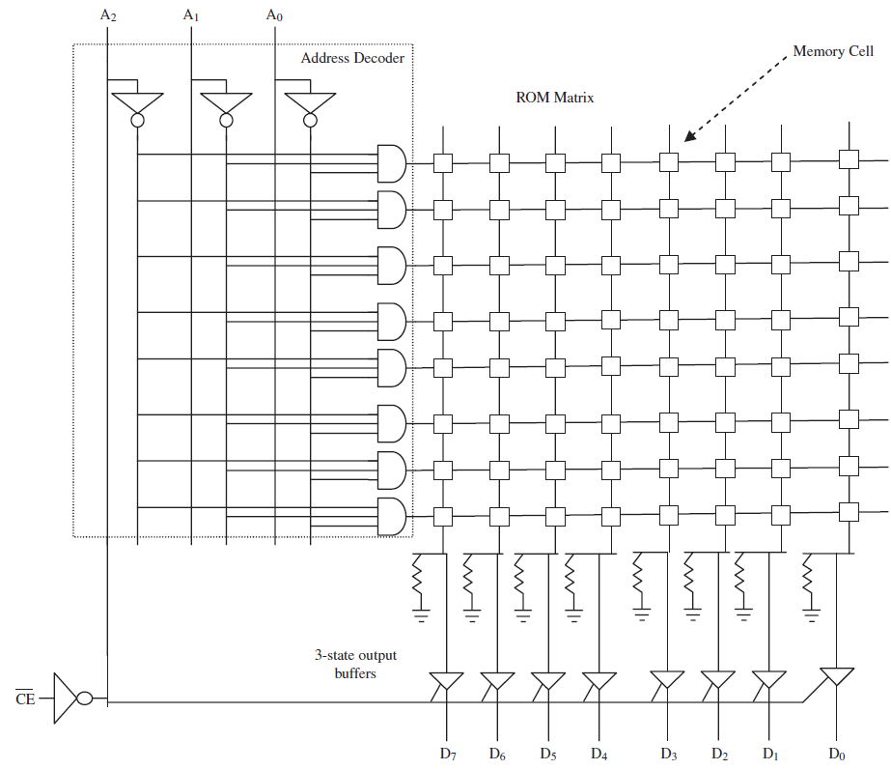

Slide 34
Addressing Modes
Addressing modes define how the processor can access operand storage.
Memory addressing modes define usage of memory and registers.
Two common types of addressing mode models:
Load-Store Architectures: only allows operations to process data in registers, not anywhere else in memory.
Eg.: PowerPC: load and store instructions: register plus displacement
Register-Memory Architectures: allows operations to be processed both within register and other types of memory.
Eg.: Intel’s i960 Jx processor: based upon the register-memory model (absolute, register-indirect)

Slide 35
Interrupts and Exception Handling
Interrupts: mechanisms that stop the standard flow of the program.
Execute another set of code in response to some event, such as problems with the hardware, resets, and so forth

Slide 36
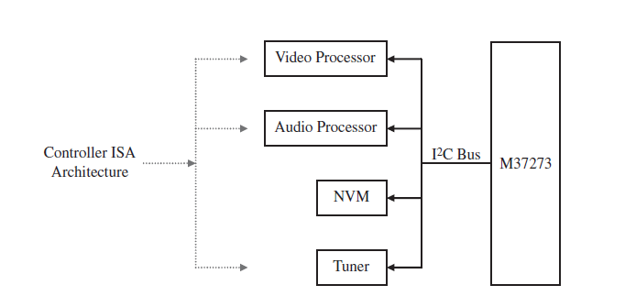
Application-Specific ISA Models
Controller Model
Implemented in processors that are not required to perform complex data manipulation,
Example-video and audio processors (used as slave processors on a TV board)

Slide 37
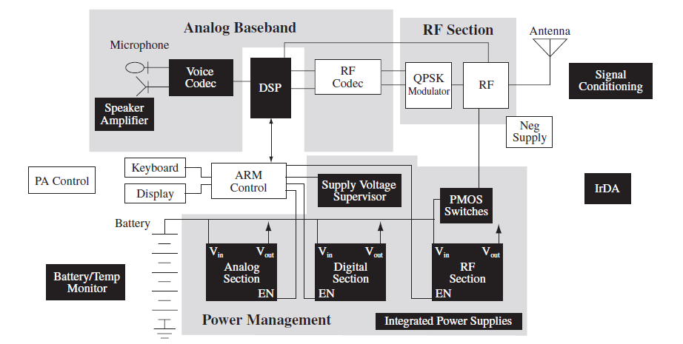
Datapath Model
implemented in processors whose purpose is to repeatedly perform fixed computations on different sets of data.
Eg. DSP processors

Slide 38
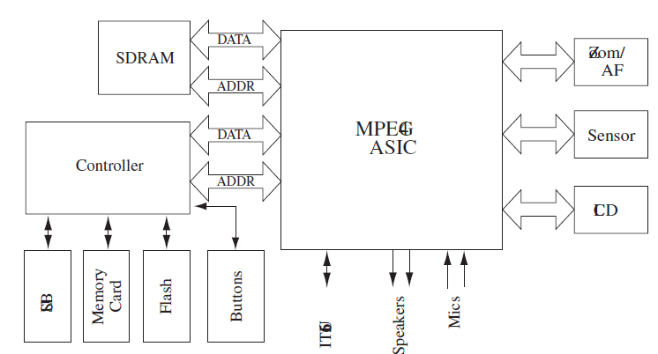
Finite State Machine with Datapath (FSDM) Model
Combination of the Datapath ISA and the Controller ISA
Used for processors that are not required to perform complex data manipulation and must repeatedly perform fixed computations on different sets of data.
Eg. - application-specific integrated circuits (ASICs), programmable logic devices (PLDs), and field-programmable gate-arrays (FPGAs).

Slide 39
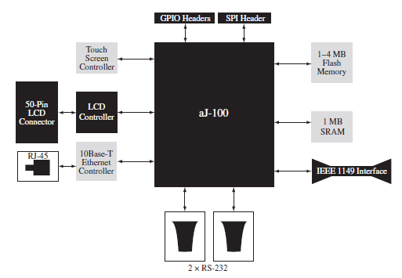
Java Virtual Machine (JVM) Model
The JVM ISA is based upon one of the Java Virtual Machine standards (Sun Microsystem’s Java Language).
Real-world JVMs can be implemented in an embedded system via hardware, such as in aJile’s aj-80 and aj-100 processors,

Slide 40
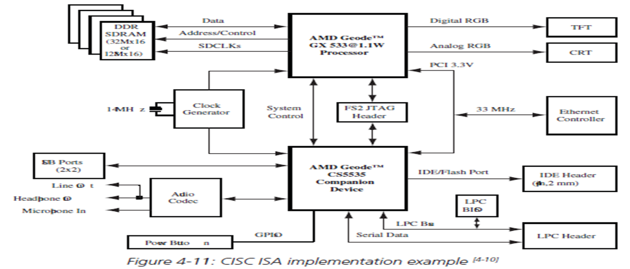
General Purpose ISA Models
Complex Instruction Set Computing (CISC) Model
Defines complex operations made up of several instructions.
CISCs typically have multiple-cycle operations.
Examples of architectures that implement a CISC ISA –
Intel’s x86 and Motorola/Freescale’s 68000 families of processors.

Slide 41
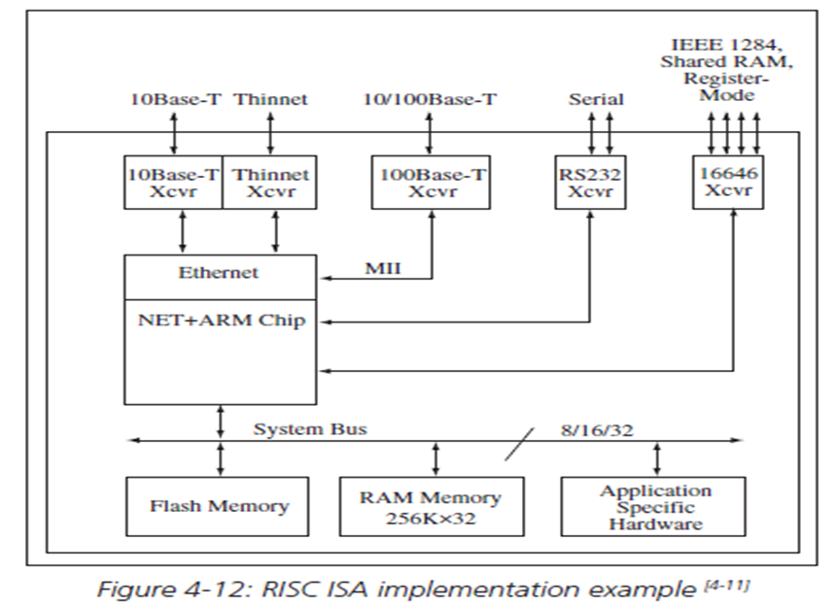
Reduced Instruction Set Model (RISC) Model
Architecture with simpler and/or fewer operations made up of fewer instructions.
architecture that has a reduced number of cycles per available operation.
Many RISC processors have only one-cycle operations,
Eg.:- ARM, PowerPC, SPARC, and MIPS

Slide 42
Instruction-Level Parallelism ISA Models
These ISA architectures execute multiple instructions in parallel, as the name implies.
Considered as higher evolutions of the RISC ISA.
Example-
Single Instruction Multiple Data (SIMD) Model,
Superscalar Machine Model,
Very Long Instruction Word Computing (VLIW) Model

Slide 43
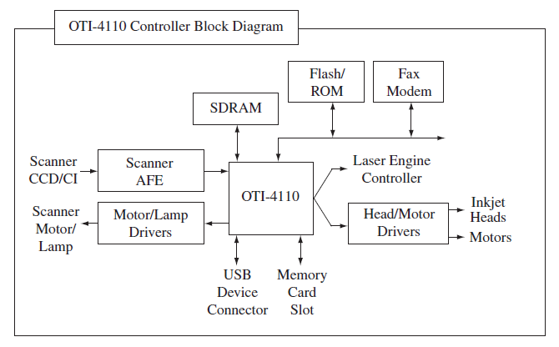
Single Instruction Multiple Data (SIMD) Model
Designed to process an instruction simultaneously on multiple data components that require action to be performed on them.

Slide 44
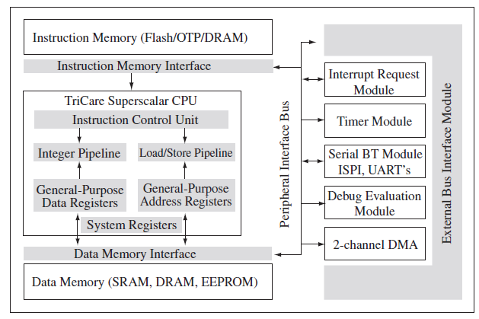
Superscalar Machine Model
Able to process multiple instructions simultaneously within one clock cycle through the implementation of multiple functional components within the processor

Slide 45
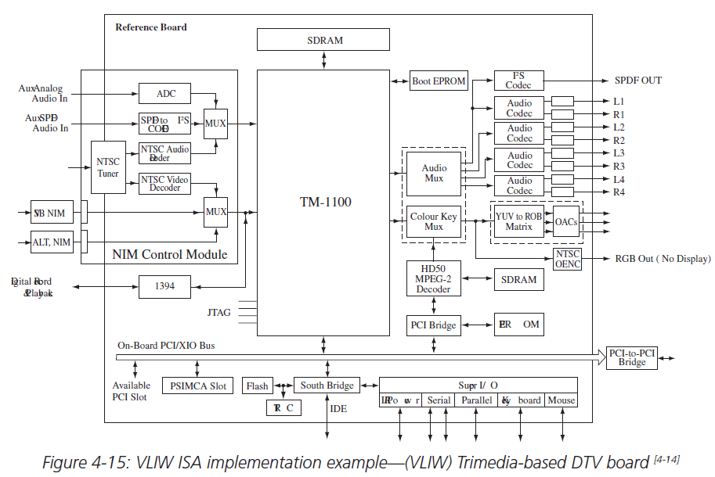
Very Long Instruction Word Computing (VLIW) Model
The VLIW ISA defines an architecture in which a very long instruction word is made up of multiple operations.
These operations are then broken down and processed in parallel by multiple execution units within the processor.

Slide 46
Internal Processor Design
The ISA defines what a processor can do, and it is the processor’s internal interconnected hardware components that physically implement the ISA’s features.
Components of ISA <=> Components of embedded board
CPU
Memory
I/O components
Buses

Slide 47
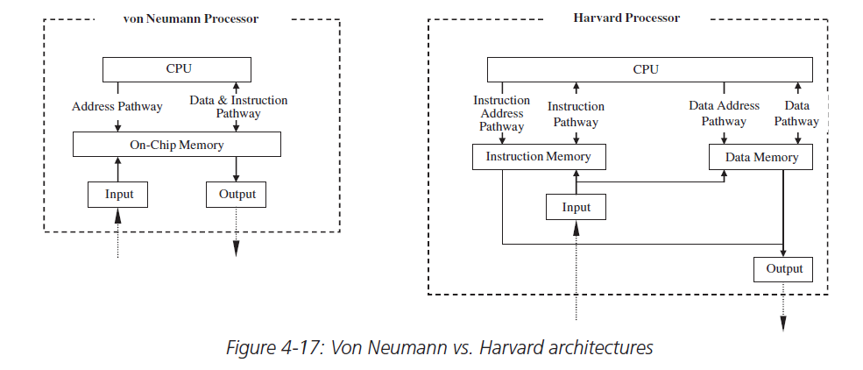
Von-Neumann vs Harvard Architectures

Slide 48
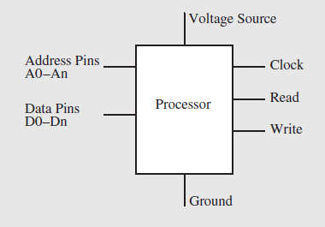
Von-Neuman & Processor Pins
Processors typically have address and data signals to read and write data to and from memory.
In order to communicate to memory or I/O, a processor usually has some type of READ and WRITE pins to indicate it wants to retrieve or transmit data.

Slide 49
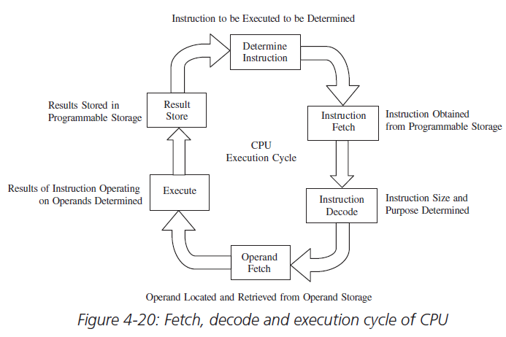
Central Processing Unit (CPU)
the processing unit within a processor.
The CPU is responsible for executing the cycle of fetching, decoding, and executing instructions.

Slide 50
CPU- von-Neumann
CPU components
the arithmetic logic unit (ALU) – implements the ISA’s operations
registers – a type of fast memory
the control unit (CU) – manages the entire fetching and execution cycle
the internal CPU buses – interconnect the ALU, registers, and the CU

Slide 51
Internal CPU buses
mechanisms that interconnect the CPU’s other components: the ALU, the CU, and registers.
Bus types:
Data bus – carries data, bi-directionally, between registers and the ALU
Address bus - which carries the locations of the registers that contain the data to be transferred
Control bus - which carries control signal information, such as timing and control signals

Slide 52
ALU
The arithmetic logic unit (ALU) implements the comparison, mathematical and logical operations defined by the ISA.
ALU is responsible for accepting multiple n-bit binary operands and performing any logical (AND, OR, NOT, etc.), mathematical (+, –, *, etc.), and comparison (=, <, >, etc.) operations on these operands.
Basic building block - Full-adders

Slide 53
Registers
Registers are simply a combination of various flip-flops that can be used to temporarily store data or to delay signals.
Storage register - fast programmable internal processor memory usually used to temporarily store, copy, and modify operands
Shift register - delay signals by passing the signals between the various internal flip-flops with every clock pulse
the number of flip-flops in each register that is actually used to describe a processor → Eg.: 32 bit register size = 32 flipflop = 32 bit processor
General purpose & special purpose – using flags

Slide 54
Control Unit
The control unit (CU) is primarily responsible for generating timing signals.
controlling and coordinating the fetching, decoding, and execution of instructions in the CPU.

Slide 55
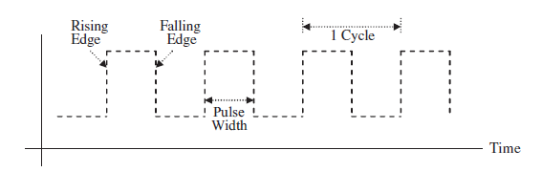
CPU & Master (System) clock
A processor’s execution is ultimately synchronized by an external system or master clock, located on the board.
Fixed frequency sequence of regular on/off pulse signals (square waves).

Slide 56
On-Chip Memory

Slide 57
Common Types
MROM
PROMs
EPROM
EEPROM-Flash Memory

Slide 58
Bipoloar Memory cells

Slide 59
SRAM & DRAM

Slide 60
16Kx8 SRAM

Slide 61
Memory Managers
Memory controller
provide glueless interfaces to the different types of memory in the system, such as cache, SRAM, and DRAM,
synchronizing access to memory and verifying the integrity of the data being transferred.
MMU
used to translate logical addresses into physical addresses (memory mapping)
handles memory security, control cache,
handles bus arbitration between the CPU and memory, and
generates appropriate exceptions

Slide 63
Processor Performance
Amount of work CPU completes in given time – throughput
Processor’s execution – synchronized with master clock
Clock cycles/clock rate - > to control and coordinate with fetching, decoding and execution of instructions.
CPU’s clock rate is expressed in MHz.
CPU’s execution time → Total time the processor takes to process some program in seconds.
length of time a CPU takes to complete a clock cycle = inverse of the clock rate (1/clock rate) → clock period or cycle time
Unit of CPC – seconds per cycle

Slide 64
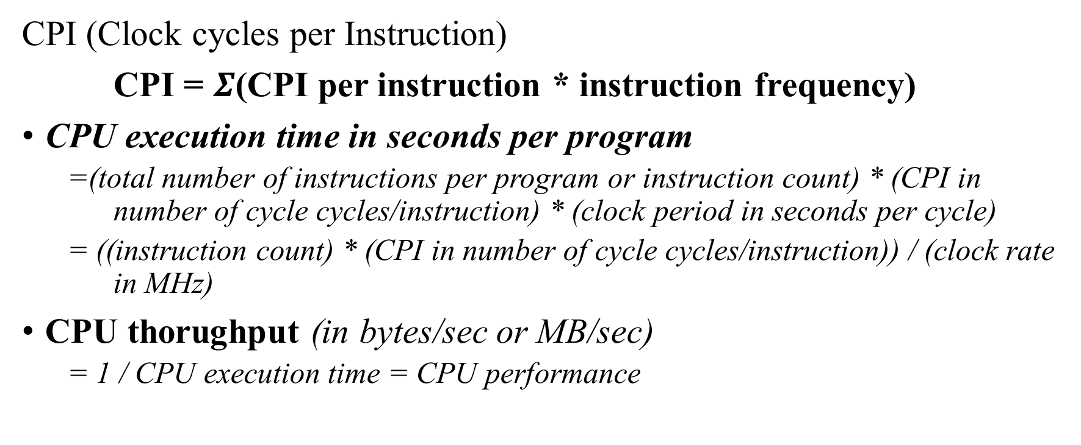
CPI (Clock cycles per Instruction)
CPI = $Σ$(CPI per instruction * instruction frequency)
CPU execution time in seconds per program
=(total number of instructions per program or instruction count) * (CPI in number of cycle cycles/instruction) * (clock period in seconds per cycle)
= ((instruction count) * (CPI in number of cycle cycles/instruction)) / (clock rate in MHz)
CPU thorughput (in bytes/sec or MB/sec)
= 1 / CPU execution time = CPU performance

Slide 65
Other measures
Latency: length of elapsed time a processor takes to respond to some event.
Availability: the amount of time the processor normally runs without failure
Reliability: the average time between failures or MTBF (mean time between failures)
Recoverability: the average time the CPU takes to recover from failure or MTTR (mean time to recover).

Slide 66
MIPS and Myths!
MIPS = Instruction Count / (CPU execution time * 106)
= Clock Rate / (CPI * 106)
Faster processor – higher MIPS?
Instruction complexity and functionality aren’t taken in the MIPS formula, So, MIPS cannot compare the capabilities of processors with different ISAs.
MIPS can vary on the same processor when running different programs (with varying instruction counts and different types of instructions).
Software programs called benchmarks can be run on a processor to measure its performance

Slide 67
Board I/O
Different categories of I/O components:
Networking and communications I/O
Input (keyboard, mouse, remote control, vocal, etc.)
Graphics and output I/O (touch screen, CRT, printers, LEDs, etc.)
Storage I/O (optical disk controllers, magnetic disk controllers, magnetic tape controllers,etc.)
Debugging I/O (BDM, JTAG, serial port, parallel port, etc.)
Real time and miscellaneous I/O (timers/counters, analog-to-digital converters and digital-to-analog converters, key switches, and so on)

Slide 69
I/O systems –Logical components
Communication Interface
Transmission Medium
Communication port
I/O Controller
I/O bus
Master Processor
Use of I/O device controller/connectors/ports is depend on the features of I/O device and its performance.

Slide 70
Data management
Serial I/O
Serial interfaces-Manages the serial data transmission and reception between the master CPU and either the I/O device or its controller
Buffers, encode/decode the data
Differs mainly in the direction of data transmission and reception
Data can be transmitted in any of the three directions
One way
Two way at separate times
Two way simultaneously

Slide 71
Transmission Scheme
Simplex
Half Duplex
Full Duplex

Slide 72
Serial I/O example:RS232
Compatible devices are called as DCE(Data Circuit-terminating Equipment)/DTE((Data Terminal Equipment))

Slide 73
Synchronous-data transfers at regular interval
Asynchronous-data transfers at irregular interval

Slide 74
EIA Standards

Slide 75
EIA-574

Slide 76
EIA-561
Two DTE devices are connected with null modem!

Slide 77
Parallel I/O
Similar to serial I/O
Example Graphics Engine

Slide 78
Parallel/Serial
Medium Dependent Interface - network port
Medium Attachment Unit - transceiver
Physical Medium Attachment - Conversion of code
Attachment Unit Interface - carry signals
Physical Layer Signaling - provides carrier signal
Media Access Control – initiates transmission

Slide 80
Interfacing an I/O Controller and the Master CPU
An ability of the master CPU to initialize and monitor the I/O Controller -control registers, status registers
A way for the master processor to request I/O
- special I/O instructions (I/O mapped) / memory-mapped I/O
A way for the I/O device to contact the master CPU
- interrupt driven I/O.
Some mechanism for both to exchange data
- programmed transfer
- memory-mapped I/O schemes

Slide 81
I/O and Performance
The data rates of the I/O devices.
The speed of the master processor.
How to synchronize the speed of the master processor to the speeds of I/O.
How I/O and the master processor communicate.
- dedicated I/O controller?
- communication scheme(intdriven/mm/prgm)

Slide 82
Summary
Embedded processor – what is made of
Concepts of ISA
Processor design – ISA
Von Neumann model – components of embedded board
Processor performance measures

